Slide 1
EU consumer habits regarding fishery and aquaculture products
Focus: consumer groups
in Bulgaria

Slide 2
Types of products bought: fresh products
Legend
S-E | Self-employed
MAN | Managers
OWC | Other white collars
MAW | Manual workers
HOU | House persons
UNE | Unemployed
RET | Retired
STU | Students

Slide 3
Types of products bought: frozen products
Legend
S-E | Self-employed
MAN | Managers
OWC | Other white collars
MAW | Manual workers
HOU | House persons
UNE | Unemployed
RET | Retired
STU | Students

Slide 4
Types of products bought: smoked, salted, dried products or products in brine
Legend
S-E | Self-employed
MAN | Managers
OWC | Other white collars
MAW | Manual workers
HOU | House persons
UNE | Unemployed
RET | Retired
STU | Students

Slide 5
Types of products bought: tinned products
Legend
S-E | Self-employed
MAN | Managers
OWC | Other white collars
MAW | Manual workers
HOU | House persons
UNE | Unemployed
RET | Retired
STU | Students

Slide 6
Types of products bought: breaded / ready-to-eat products
Legend
S-E | Self-employed
MAN | Managers
OWC | Other white collars
MAW | Manual workers
HOU | House persons
UNE | Unemployed
RET | Retired
STU | Students

Slide 7
Frequency of purchase by age group
% buy at least from time to time

Slide 8
Frequency of purchase by socio-demographic group
% buy at least from time to time
Legend
S-E | Self-employed
MAN | Managers
OWC | Other white collars
MAW | Manual workers
HOU | House persons
UNE | Unemployed
RET | Retired
STU | Students

Slide 9
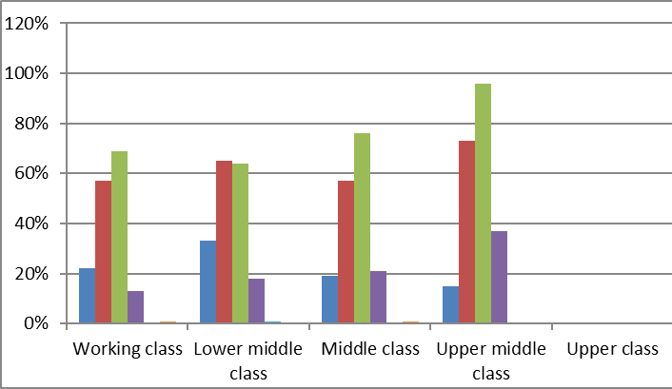
Where do people buy?
Legend
S-E | Self-employed
MAN | Managers
OWC | Other white collars
MAW | Manual workers
HOU | House persons
UNE | Unemployed
RET | Retired
STU | Students

Slide 10
Trying new products
Do you agree or disagree with the following statements : you like to try new products and species?
Legend
S-E | Self-employed
MAN | Managers
OWC | Other white collars
MAW | Manual workers
HOU | House persons
UNE | Unemployed
RET | Retired
STU | Students

Slide 11
Reasons to eat/buy FAPs
Legend
S-E | Self-employed
MAN | Managers
OWC | Other white collars
MAW | Manual workers
HOU | House persons
UNE | Unemployed
RET | Retired
STU | Students

Slide 12
Main purchasing factors
Legend
S-E | Self-employed
MAN | Managers
OWC | Other white collars
MAW | Manual workers
HOU | House persons
UNE | Unemployed
RET | Retired
STU | Students

Slide 13
Wild or farmed?
Legend
S-E | Self-employed
MAN | Managers
OWC | Other white collars
MAW | Manual workers
HOU | House persons
UNE | Unemployed
RET | Retired
STU | Students

Slide 14
From where?
Do you have any preference in terms of product origin?
Legend
S-E | Self-employed
MAN | Managers
OWC | Other white collars
MAW | Manual workers
HOU | House persons
UNE | Unemployed
RET | Retired
STU | Students

Slide 15
Interest for voluntary information
Which of the following do you think should be mentioned on the label for all fishery and aquaculture products?

Slide 16
Thank you! http://ec.europa.eu/commfrontoffice/publicopinion/index.cfm/survey/getsurveydetail/instruments/special/surveyky/2206

